Slide 1

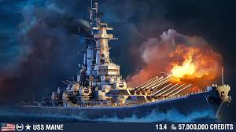

DSA PROJECT
BATTLESHIP
Tô Duy Thịnh ITCSIU22138

Slide 2

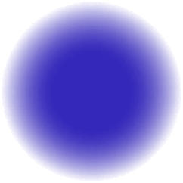
Each player starts with a grid and places 10 ships: lengths 5, 5, 4, 4, 3, 3, 2, 2, 1, 1 (horizontally or vertically).
Ship positions are hidden from the opponent.
Players take turns attacking an unselected position on the opponent’s grid.
Markers: Blue (miss), Red (hit).
When all positions of a ship are hit, it is revealed as destroyed.
The game ends when all ships of one player are destroyed. The player with remaining ships wins.
GAMEPLAYS

Slide 3

Liceria Tech
REQUIREMENTS
Use vscode, github
Code with jdk17
Some class like: BattleshipAl.java, Game.java, GamePanel.java, Marker.java, Position.java, Rectangle.java, SelectionGrid.java, Ship.java, SimpleRandomAl.java, SmarterAl.java, StatusPanel.java,...

Slide 4
SimpleRandomAl.java
SmarterAl.java
AI

Slide 5
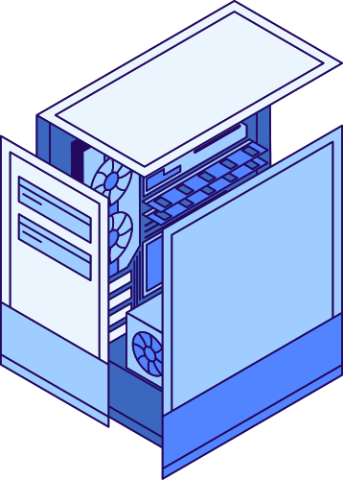
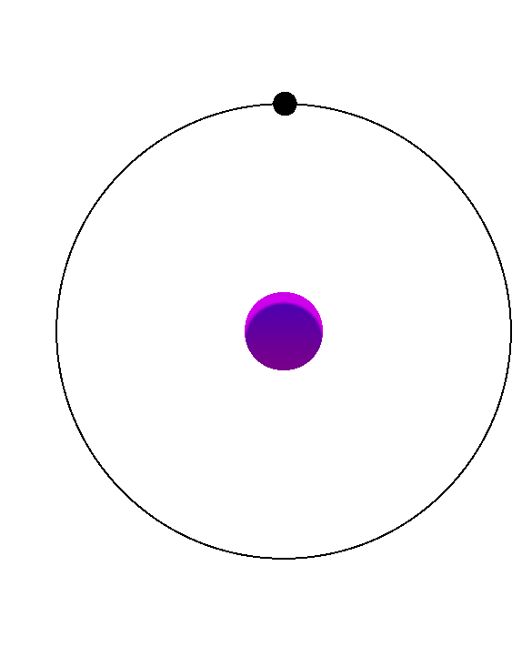
SMARTERAL.JAVA
·Suppose AI hits at (3,3):
Add (3,3) to shipHits.
On the next turn:
If preferMovesFormingLine = true: Find a direction with at least 2 consecutive hit squares (eg: (3,4)).
Otherwise, randomly select adjacent cells.
When the ship is completely destroyed:
Remove all ship coordinates from shipHits.
If the ship is not hit:
Continue searching for cells with many surrounding cells that have not been attacked (findMostOpenPosition).

Slide 6

Liceria Tech
SIMPLERANDOM
AI.JAVA
AI choose randomly
Do not continuous to destroy the ship

Slide 7
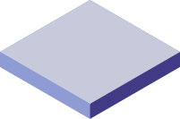
DEMO

Slide 8

THANK YOU!
https://github.com/toduythinh/DSA_PROJECT

